Slide 1

CS 6120
Project Presentation
Question-Answering model
using BERT and its derivatives
Group members:
Soham Shinde
Omkar Pradhan
Shuchita Mishra
Notes:
Hello everyone!
Welcome to our Project Presentation for CS 6120.
The topic for out project is “Question-Answering model using BERT and its derivatives”
The Group Members are Soham Shinde, Omkar Pradhan and Shuchita Mishra.

Slide 2
Index
Introduction
Dataset
Data preprocessing
Modeling
Evaluation
Results
Conclusion
Responsibilities
Notes:
Through the course of this presentation, we will go over *READ SLIDE*

Slide 3
Introduction
Designing a Question and Answering (Q&A) system is a critical problem in the field of NLP and IR
Extensive use case and applications in businesses, academia and lifestyle
Helps to access the immense information and create systems which can answer natural language queries with relevant information
Q&A systems aid in rapidly getting the desired information without the need to go through the entire corpus
Notes:
Question Answering Systems allow a user to express a question in natural language and get an immediate and brief response. This is why it is an important problem in Natural Language Processing.
QnA systems are used in various application across the fields of business, education and lifestyle. For eg. search engines and phone conversational interfaces
They enable us to properly use the huge amounts of information available and answer queries posted in form of natural language
Most importantly, the help in saving time and effort by eliminating the need to scan the entire the corpus of documents

Slide 4

Problem Statement
Ubiquitous, helpful and fun!
Q&A systems take in the input as a question in natural language and output a brief and immediate response
Reading comprehension is the ability to read a piece of text and then answer questions about it
The project aims to predict answers to the given set of questions with the help of embedding and transformer based models and evaluate their results
Notes:
The input to this system is a question in natural language and output is a relevant answer in response
We should remember that ….
Read
The main results we want to have are the answers after reading the comprehension questions based on the provided paragraph
So we will aim to get the correct solution to the sentence and then elicit the correct response from the sentence once we completed it.
Read from slides

Slide 5
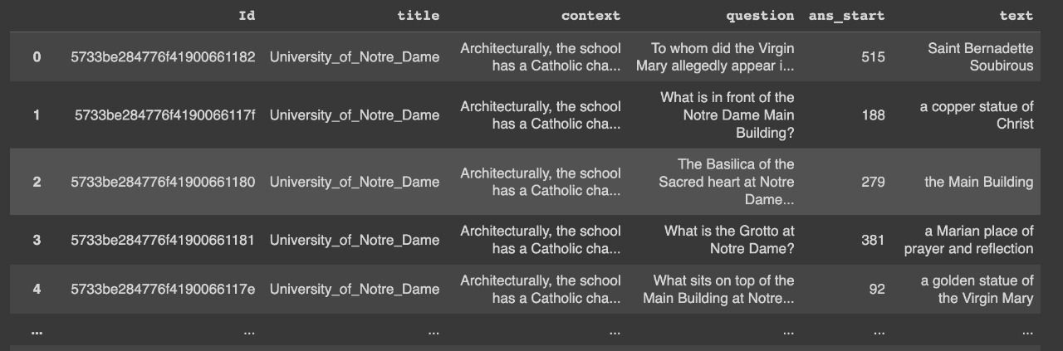
Dataset
Stanford Question Answering dataset (SQuAD)
It consists of text answers to every question from a reading passage
Each record in the dataset contains text question, text answer, context and position in context
Containing more than 100k question answer pairs on 500+ articles, this dataset would be used for training purposes (Version: v1.1)
Notes:
Read slide

Slide 6

Data Preprocessing
Data being in JSON format is converted to equivalent .csv format for modelling
Generate whole answer sentences to evaluate on similarity of the answers
Maximum length of the sequences is set to relatively decrease the training time and be compatible with Colab RAM
Max_len = 384, resulting in 1.2% data being truncated
Tokenize data according to input parameters required by that specific model (input_ids, token_ids, etc)
Notes:
Converting JSON to .csv
Fetch and create new column answer_sentences
Pre-process using gensim and clean_text
Read

Slide 7
Modeling
PART 1
Embedding Models

Slide 8
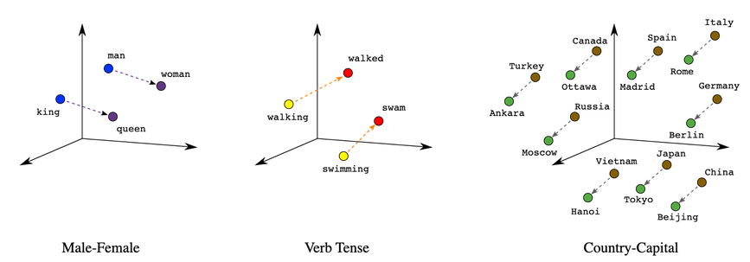
Word2Vec
Learns vector representation of words (embeddings) from the vocabulary
The same neighboring words tend to be semantically similar and this is the basic block of w2v
Once trained, the model is able to detect similarity within words and can be used to measure the cosine similarity between distinct words
the model then selects a sentence from the context that has the highest embedding similarity with the input question, and outputs it as the answer

Slide 9
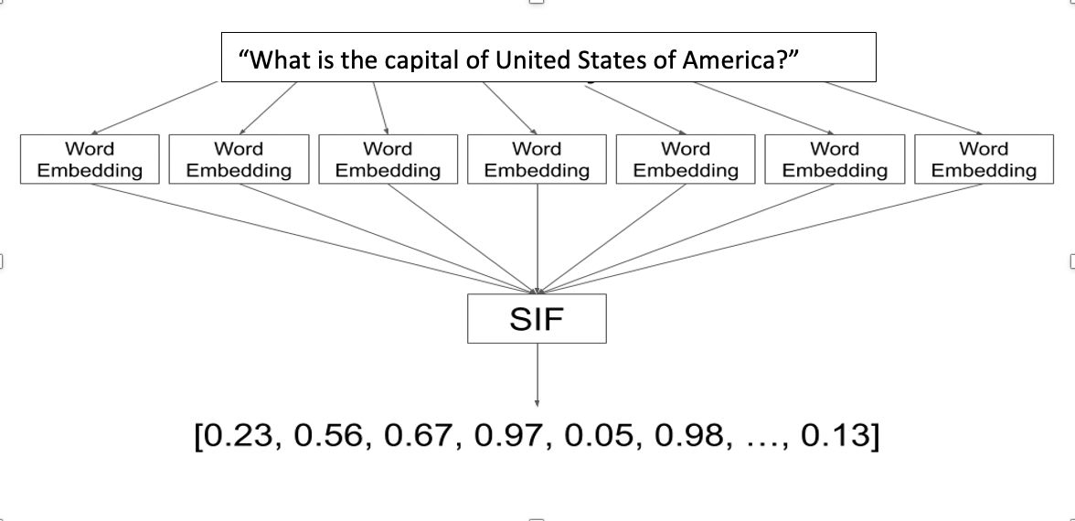
SIF
A simple unsupervised statistical method for computing sentence embeddings using a simple weighted average of word vectors
Sentence embeddings embed an entire sentence into a vector space
Based on the embeddings for the input question and each sentence in the context, we can compare the embeddings of the question and each sentence in the answer using the cosine similarity method
Smooth Inverse Frequency

Slide 10
Modeling
PART 2
Transformer Models
Notes:
Explain Transformer 2sentences 30 secs

Slide 11

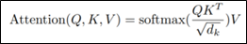
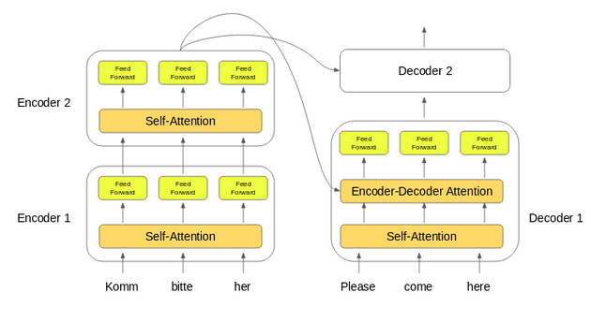
Transformers
Transformers solve seq-to-seq task based on Self-Attention representations
Notes:
The basic idea is to make use of only attention and recurrence to handle dependencies between input and output.
The Encoder part comprises a Multi-Head Attention layer followed by Feed Forward Neural Network layer. The Decoder part is like that of an encoder with an additional Multi-Head Attention layer.
Encoder to encoder and then Decoder
Attention is softmax function of Query , key and value vectors

Slide 12
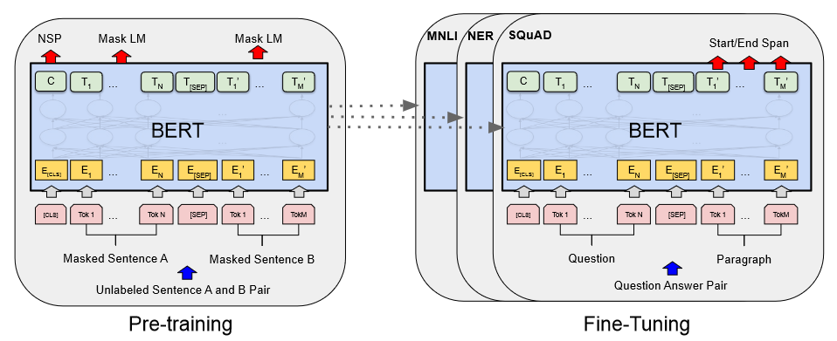
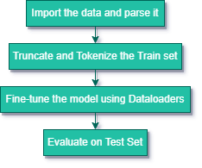
BERT
BERT is a transformer based framework developed by Google
Designed to read bidirectionally and pre-trained on Masked Language Modeling(MLM) & Next Sentence Prediction(NSP) tasks
“bert-base-uncased”
Bidirectional Encoder Representations from Transformers
Notes:
MLM is done by hiding a word in a sentence and then predicting what word using its context.
NSP determines the type of relationship between the two given sentences. It can be logical, sequential, or simply random.
Eventually, BERT model, Masked LM and Next Sentence Prediction are trained together with the objective of minimum combined loss.

Slide 13
BERT Variants
DISTILBERT
DISTILBERT uses a technique called distillation which approximates BERT i.e large neural network with a smaller one.
The main idea of DISTILBERT is that once a large neural network has been trained, its full output distributions can be approximated using a smaller network
DISTILBERT has 40% less parameters than bert-base-uncased, runs 60% faster while preserving over 95% of BERT’s performances as measured on the GLUE language understanding benchmark.
DISTILBERT
2. ALBERT

Slide 14

ALBERT
The ALBERT architecture proposed 3 main changes over BERT as follows:
Factorized embedding parameterization: The input and hidden layer embeddings have the same size in BERT, but these two embeddings are separated in ALBERT. This leads to 80% parameter reduction with a minor drop in performance compared to BERT
Cross-layer parameter sharing: ALBERT proposes sharing of parameters between different layers of model to decrease redundancy and improve accuracy. Three types of parameter sharing proposed are i. Share all parameters (default) ii. Only share the attention parameters iii. Only share feed forward network parameters. This step leads to 70% reduction in parameters.
Inter Sentence Coherence loss: ALBERT used a new loss called SOP (Sentence Order Prediction) over NSP (Next Sentence Prediction) loss used by BERT. NSP checks for coherence as well as topic to identify next sentence, however SOP only looks for sentence coherence.
Notes:
Developed by google in 2019
For bert the input and hidden layer embeddings have same size. But in case of Albert they are separated.

Slide 15
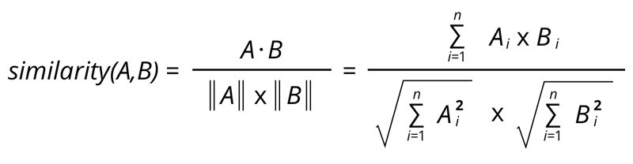
Evaluation Metrics
Cosine Similarity:
Exact Match: Number of predicted start and end indices that are equal to the correct ones are added up for this metric
F1 score: This metric score gives our model credit for predicting a span which partially intersects the correct one.
precision = 1.0 * num_same / len(pred_toks)
recall = 1.0 * num_same / len(all_toks)
f1 = (2 * precision * recall) / (precision + recall)
Notes:
The main results we want to have are the answers after reading the comprehension questions based on the provided paragraph
So we will aim to get the correct solution to the sentence and then elicit the correct response from the sentence once we completed it.

Slide 16

Results
For the embedding models, SIF clearly performs better compared to Word2Vec, as expected. The validation accuracy of SIF is 78.6%
For transformer models, our trained BERT model performs decently and we achieved an EM score of 84.06%.
ALBERT has a less accuracy because it has significantly less number of parameters compared to the BERT model, which compromises the accuracy to a certain limit.
Our ensemble (BERT+DISTILBERT) model performs marginally better than the BERT model.
Embedding Models
Model | train accuracy | val accuracy
W2v | 66.0 | 69.6
SIF | 76.8 | 78.6
Transformer Models
Models | EM | F1
BERT | 84.06 | 86.5
ALBERT | 63.33 | 73.8
DISTILBERT | 80.69 | 82.7
ENSEMBLE | 84.67 | 86.9
Notes:
The main results we want to have are the answers after reading the comprehension questions based on the provided paragraph
So we will aim to get the correct solution to the sentence and then elicit the correct response from the sentence once we completed it.

Slide 17



Sample Answers
Notes:
2 main obs
W2v ans sif answers are similar in most of the cases
W2v and SIF generate larger answers whereas bert gives concise answers.

Slide 18
Conclusion
The implemented models can be categorized into three categories as follows.
Embeddings models - Word2Vec and SIF
Transformers models - BERT, ALBERT, DISTILBERT
Ensemble model - DISTILBERT+BERT
We used cosine similarity as metrics for embeddings model and EM and F1 score as metric for the other two categories
In future,
explore more efficient variants of BERT like ELECTRA and ROBERTa
explore top performing ensemble architectures like IE-Net
Notes:
The main results we want to have are the answers after reading the comprehension questions based on the provided paragraph
So we will aim to get the correct solution to the sentence and then elicit the correct response from the sentence once we completed it.

Slide 19

Responsibilities
The work has been evenly split among all three members
Each member performed literature survey, research work and implemented specific models
Shuchita is responsible for implementing the embedding models of Word2Vec and SIF along with necessary data preprocessing and training
Soham implemented the BERT model with its DistilBERT variant
Omkar implemented the BERT model and trained the variant model of ALBERT
The ensemble model was attempted by Omkar and Soham
All members shared equal contribution in the documentation, reporting and analysis of the best model

Slide 20

References
[1] Dataset SQuAD 1.1:
https://rajpurkar.github.io/SQuAD-explorer/
[2] A Review of Question Answering Systems:
https://www.riverpublishers.com/journal_read_html_article.php?j=JWE/17/8/5
[3] Embedding models:
https://openreview.net/forum?id=SyK00v5xx
[4] BERT: Pre-training of Deep Bidirectional Transformers for Language Understanding:
https://arxiv.org/abs/1810.04805
[5] Exploring cosine-similarity functions:
https://www.kaggle.com/code/lidaghr/word2vec-bert-qa-diagnostics-group6-cord-19
[6] Converting SQuAD v1.1 JSON files to .csv format:
https://www.kaggle.com/code/jagannathpatta/reading-json-data-getting-dataframe
[7] Word embeddings introduction:
https://towardsdatascience.com/word-embeddings-for-nlp-5b72991e01d4
[8] SIF Embeddings calculation:
https://engineering.talkdesk.com/what-are-sentence-embeddings-and-why-are-they-useful-53ed370b3f35

Slide 21
Thank You

